Slide 1

What’s killing Americans?
Data Understanding and Preparation
Team Adams
Team Members: Pradeep Kumar M
Harsh Solanki
Priyanka Priya
Shiva R

Slide 2
Content
Business Need and Introduction to Dataset
Data Understanding: - Entity Relationship Diagram - Normalization - Uploading Data
Analysis with SQL Queries
Visualization
Recommendations
Lessons Learned

Slide 3


Business Need and Introduction to Dataset

Slide 4








Business Need and Introduction to Dataset
This project is an attempt to analyze and recognize the correlation between various living factors and mortality due to major diseases in USA. These correlation will help governments in devising policies and initiatives at a County level
67,000+ records
Comprehensive Census Data highlighting Demographics, Income, Nature of Employment, Mode of Transport, Population count granular to ethnicity at county level
A rich and complete collection of mortality rates corresponding to different categories for all counties across the USA
Mortality Rate Data of Top 21 Categories corresponding to major diseases at County level
A collective Dataset of both Census and Mortality for years 2015 & 2017 to intersperse & capture the ‘changing trends’

Slide 5

Data Understanding

Slide 6










Data Understanding
Census Data
Mortality Data
Location
Mode of Transport
Diseases and other mortality categories
Drive, Carpool, Transit, Walk, Other Transport, Mean Commute, Work at Home
County, State
Cardiovascular, Chronic respiratory, Cirrhosis and other chronic liver diseases, Diabetes, urogenital, blood, and endocrine diseases, Diarrhea, lower respiratory, and other common infectious diseases, Digestive diseases, HIV/AIDS and tuberculosis
Maternal disorders, Mental and substance use disorders, Musculoskeletal disorders
Neglected tropical diseases and malaria
Neonatal disorders, Neoplasms, Neurological disorders
Nutritional deficiencies, Other communicable, maternal, neonatal, and nutritional diseases, Other non-communicable diseases
Self-harm and interpersonal violence, Transport injuries, Unintentional injuries, Forces of nature, war, and legal intervention
Demographic
Employment Sector
Total Population, Men, Women, Hispanic, White, Black, Native, Asian, Citizen
Professional, Service, Office, Construction, Production
Employment Type
Private, Public, Family
Income
Income, Income Error, Income Per Capita, Income Per Capita Error, Poverty, Child Poverty
Employment Status
Employed, Self Employed, Unemployed

Slide 7
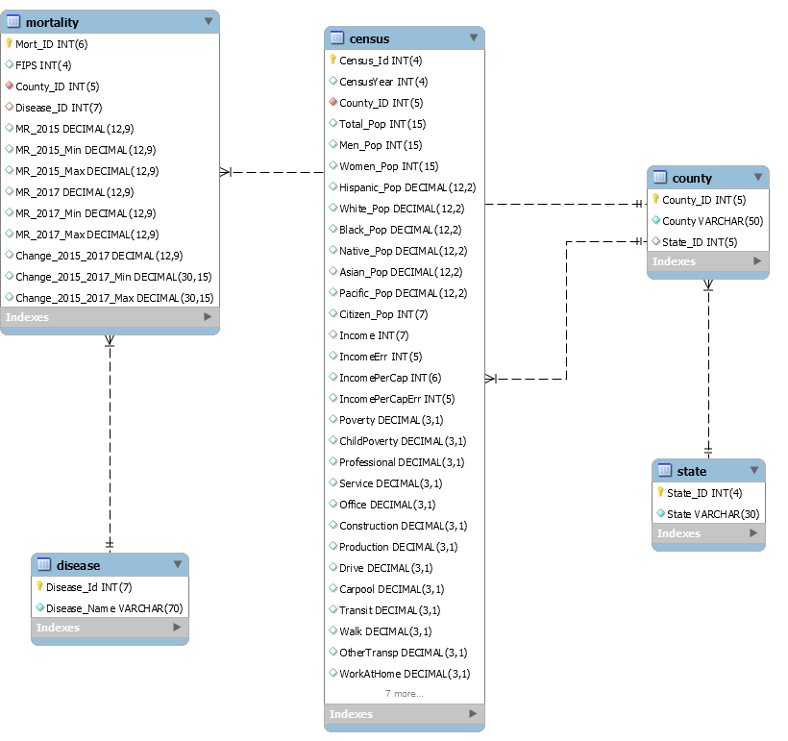
Data Understanding
1. Entity Relationship Diagram (EER)

Slide 8
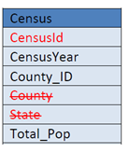
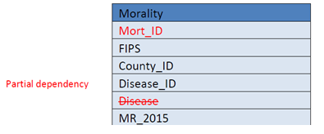
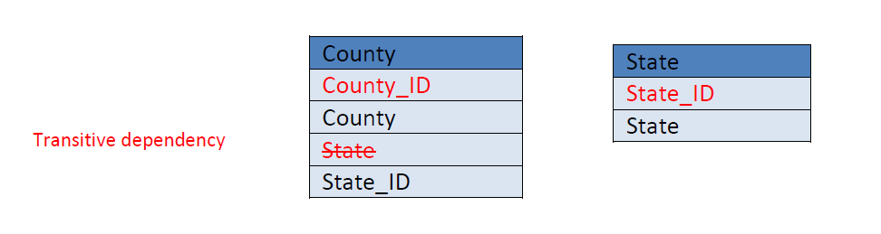
Data Understanding
2. Normalization
1st Normal form
There are no repeating groups | Yes
Data atomic | Yes
Each field has unique name | Yes
Primary Key | Yes
Partial Dependency
Transitive Dependency
First Normal Form (1NF): Each row is Unique, and no columns contains multiple values. Table for Census was mostly downloaded in first normal form. For mortality table, we had to separate county and states. It was in following form (Autauga County, Alabama)
Second Normal Form (2NF): It is in 1NF and all non-key attributes are fully functional dependent on the primary key (does not contain partial functional dependencies)
Third Normal Form (3NF): It is in 2NF and non key columns do not determine other non key columns
2nd Normal form
First normal form | Yes
All non-key attributes are dependent | Yes
Eliminate partial dependencies | Yes
3rd Normal form
First normal form | Yes
2nd normal form | Yes
Eliminate transitive dependencies | Yes
Team Adams

Slide 9





Data Understanding
3. Uploading Data
Data Cleaning *
Rows with ‘NA’ values removed or
Treated with mean
value
Removing spaces
Making counties unique
Data Sources
ETL
Records with blank spaces treated with mean value
Imported Data in CSV files
Census Data: US Census Bureau
Mortality Data: Institute for Health Metrics and Evaluation
Troubleshooting/ lessons learned*
Secured file Upload Path : secure_file_priv
sql_mode=('ONLY_FULL_GROUP_BY','')

Slide 10

Analysis with SQL Queries

Slide 11

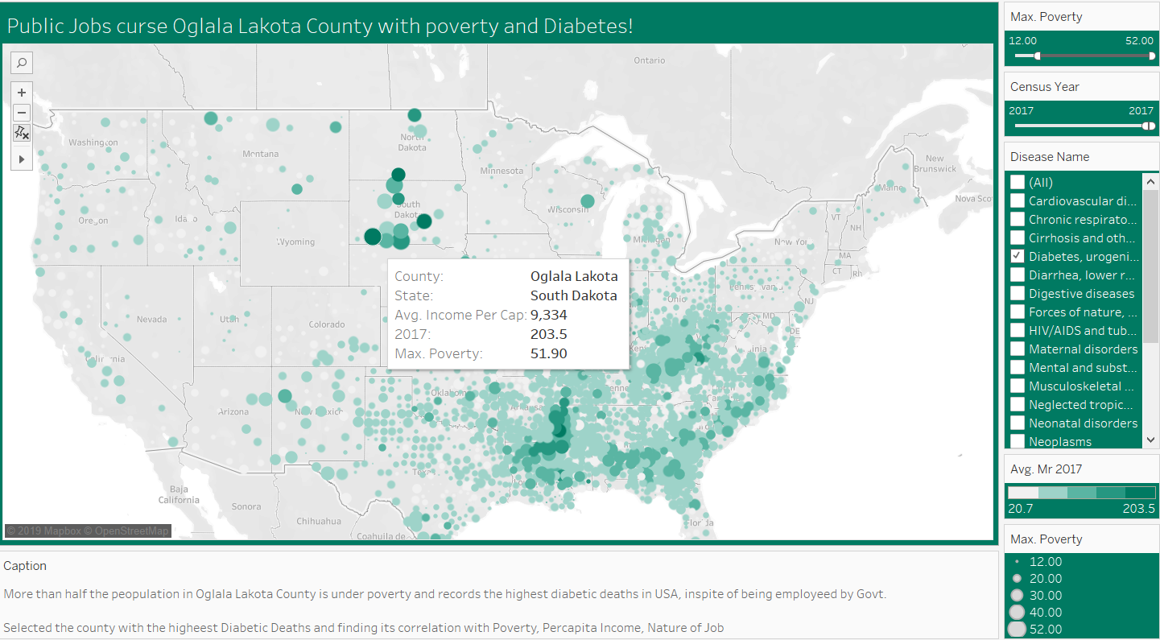
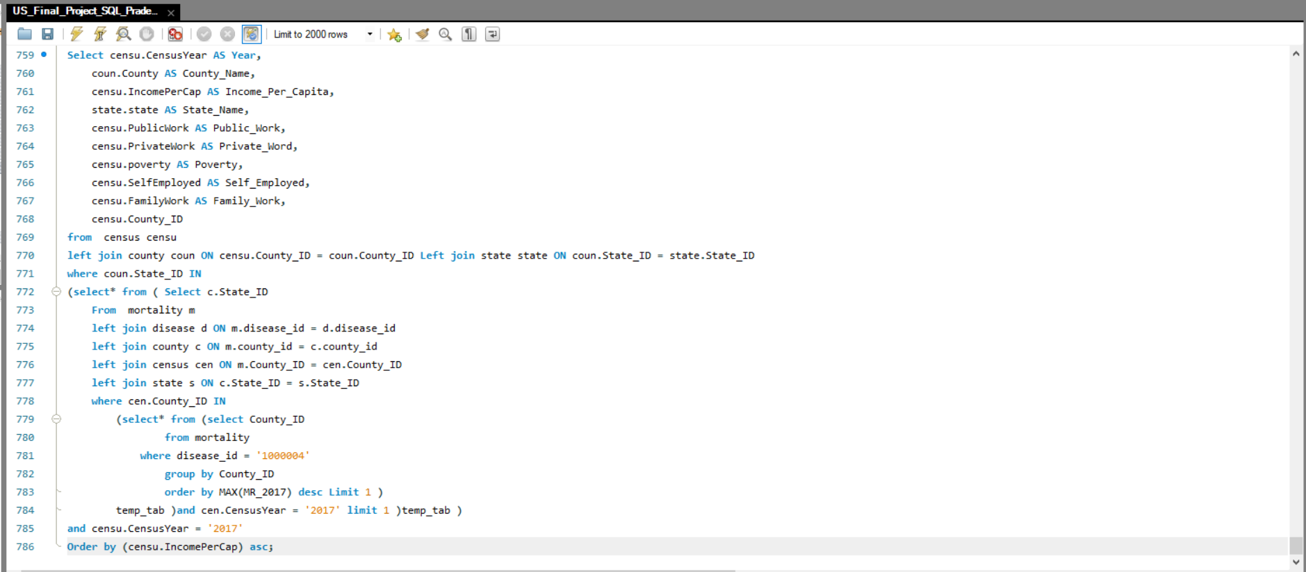
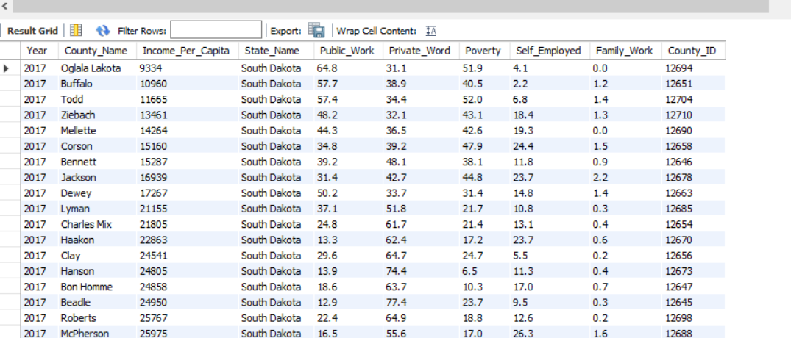
Public Jobs curse Oglala Lakota with Poverty and Diabetes!
Query-1
In 2017, Oglala Lakota County records the highest deaths due to Diabetes(across USA) having the least per capita income(across South Dakota) with half the population under poverty and majority working for public sector

Slide 12
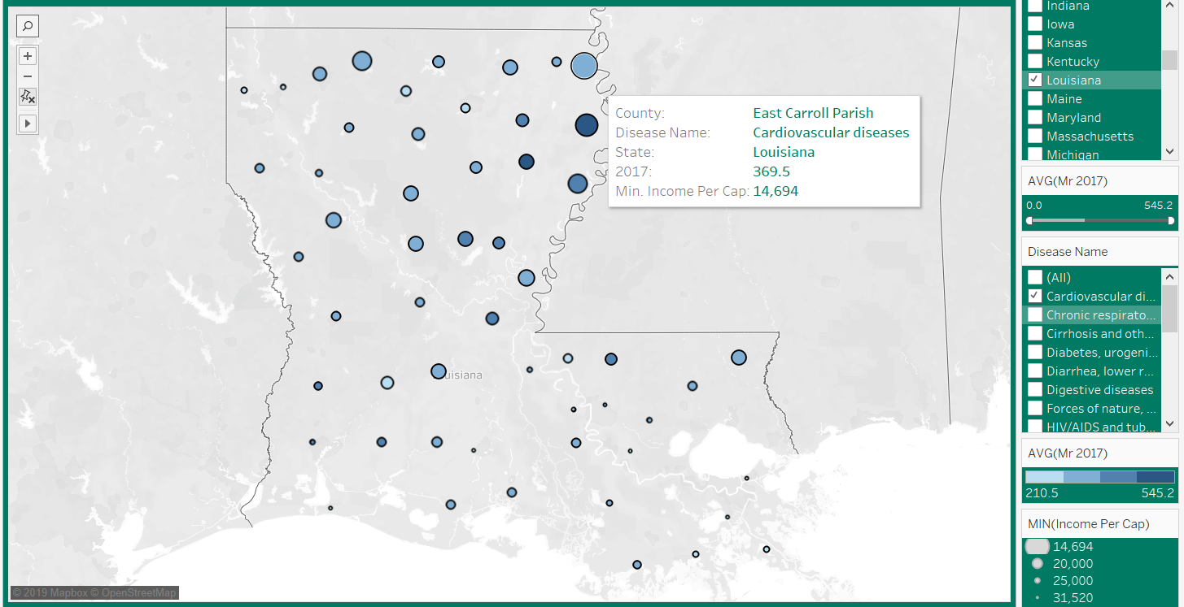
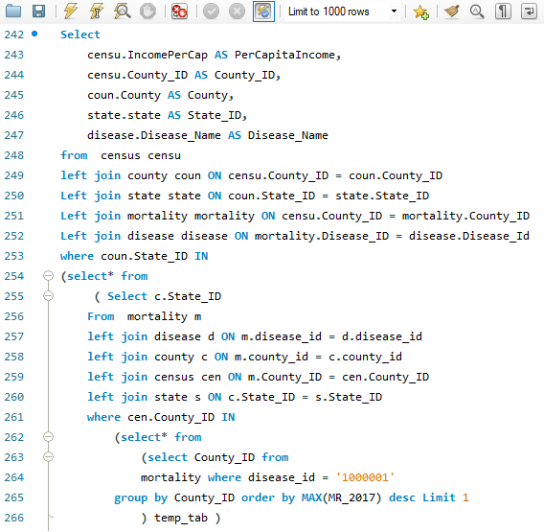
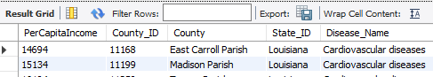
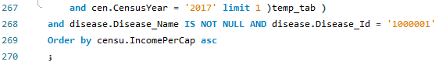
Franklin Parish suffers with Cardiovascular Diseases
Query-2
In 2017, People in Franklin Parish, Louisiana saw the highest cardiovascular deaths. Interesting to note that nearby counties have similar mortality rate. East Carroll Parish, has the least per capita income in the same state

Slide 13

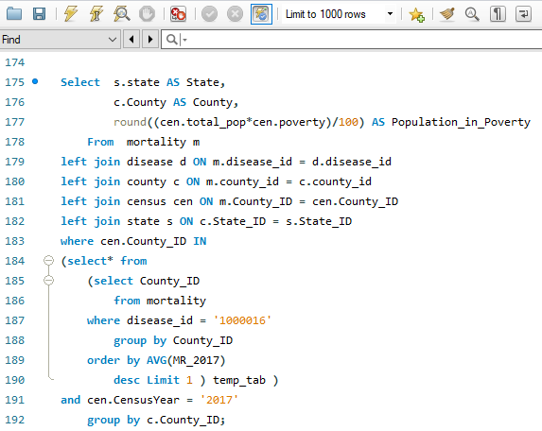
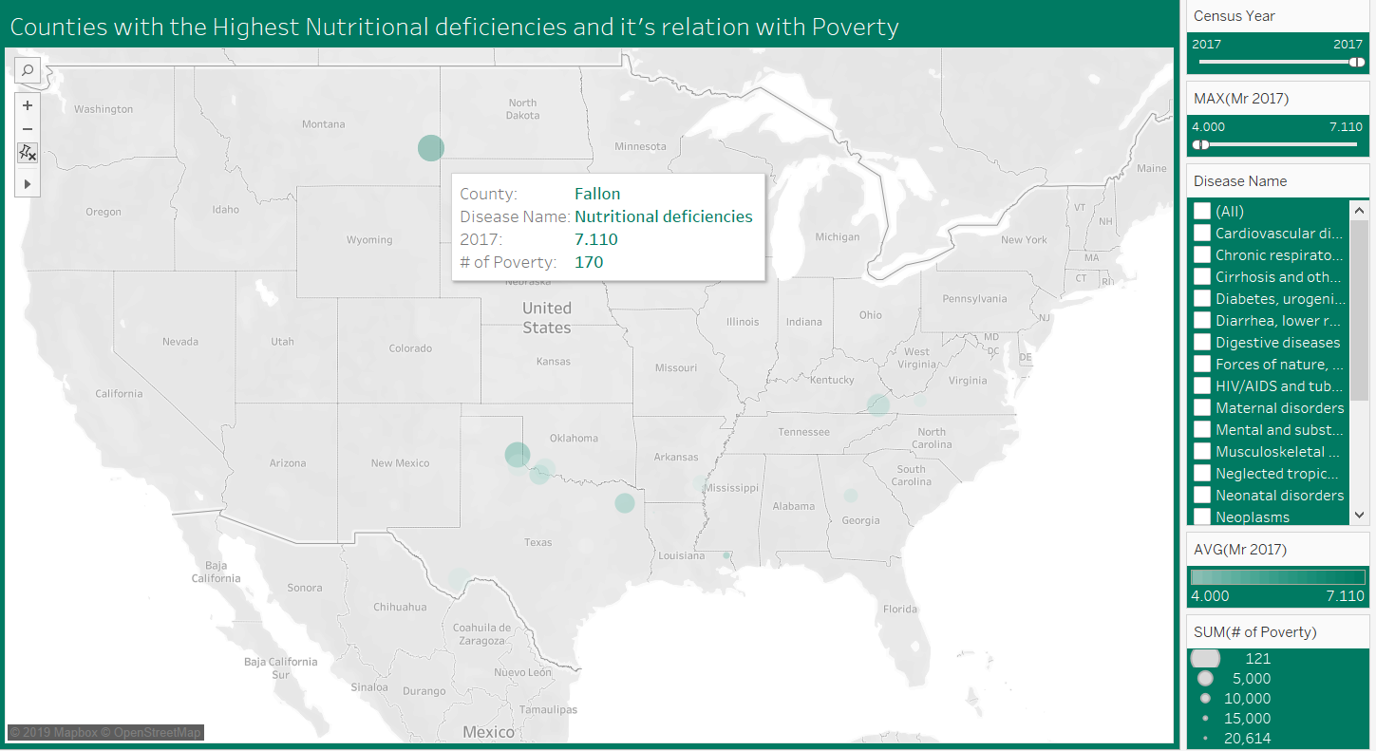
Fallon battles with Nutritional Deficiency
Query-3
In the year 2017, Fallon from Montana has the greatest number of deaths due to ‘Nutritional deficiencies’ with 170 people more susceptible to the disease because of poverty

Slide 14
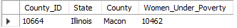
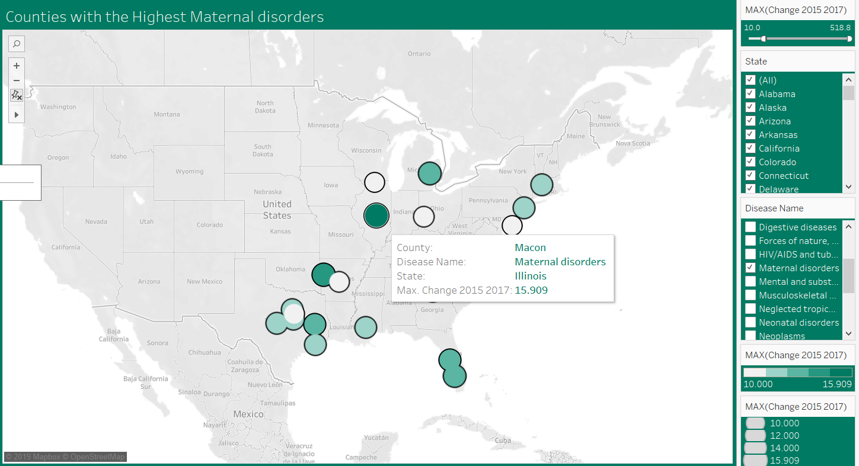
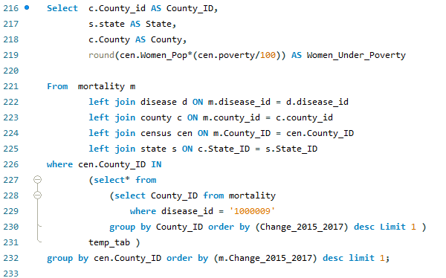
Macon’s women in growing risk with Maternal Disorders
Query-4
Women in Macon, Illinois have seen highest increase in Maternal disorders with around 10.5k women are under poverty

Slide 15
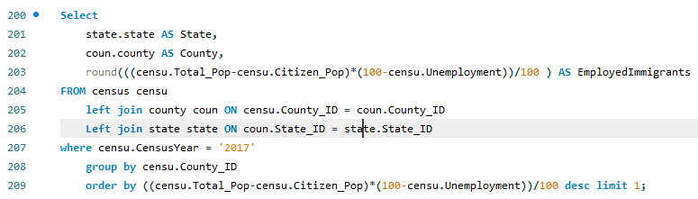
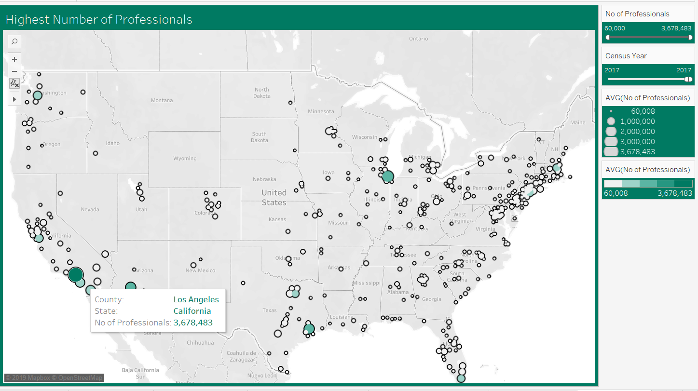
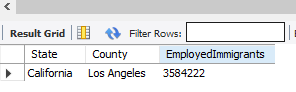
Los Angeles embracing Immigrants
Query-5
LA from CA is the most welcoming place in USA for opportunity seekers across the globe

Slide 16
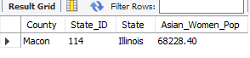
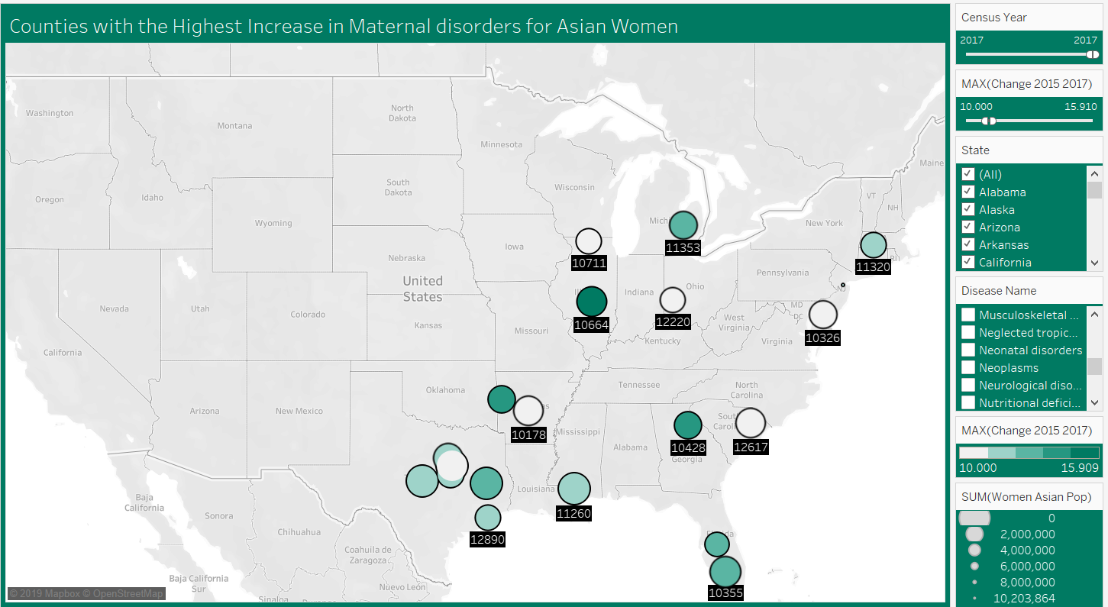
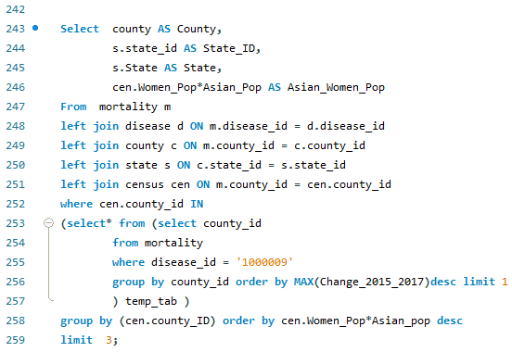
Macon’s Asian women suffer the most in maternity
Query-6
Asian Women in Macon, Illinois are recorded with highest Maternal disorders
Team Adams

Slide 17

Visualization

Slide 18

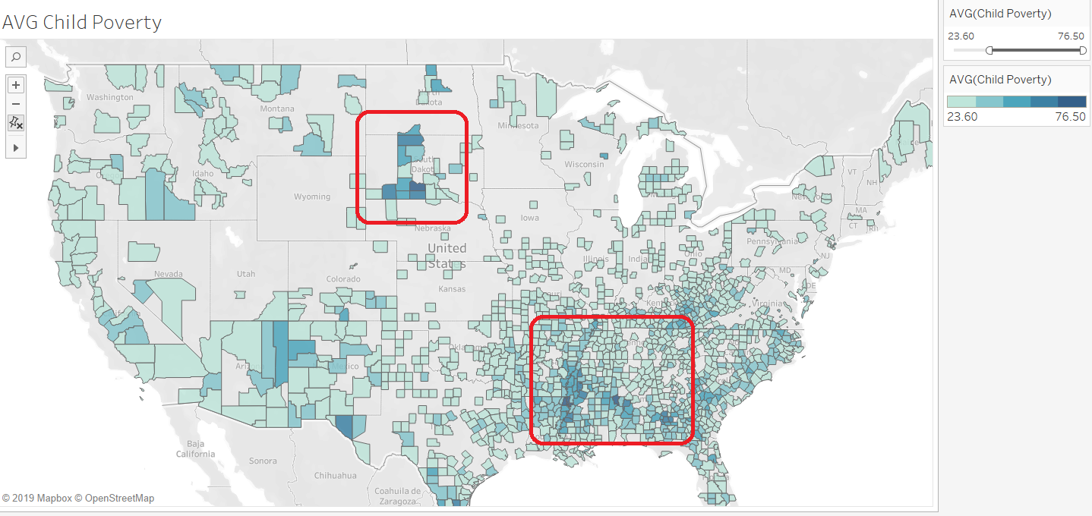
Concentration of Child Poverty VS USA Average:
Viz-1
County wise:
Greatest concern: East Carroll Parish
Least Concern: Mineral County
State wise:
Greatest concern : Mississippi Least concern: Connecticut.
Heavily concentrated in the South Dakota and Mississippi. Both possess the largest number of census tracts where child poverty is above average.
South Dakota
Mississippi

Slide 19
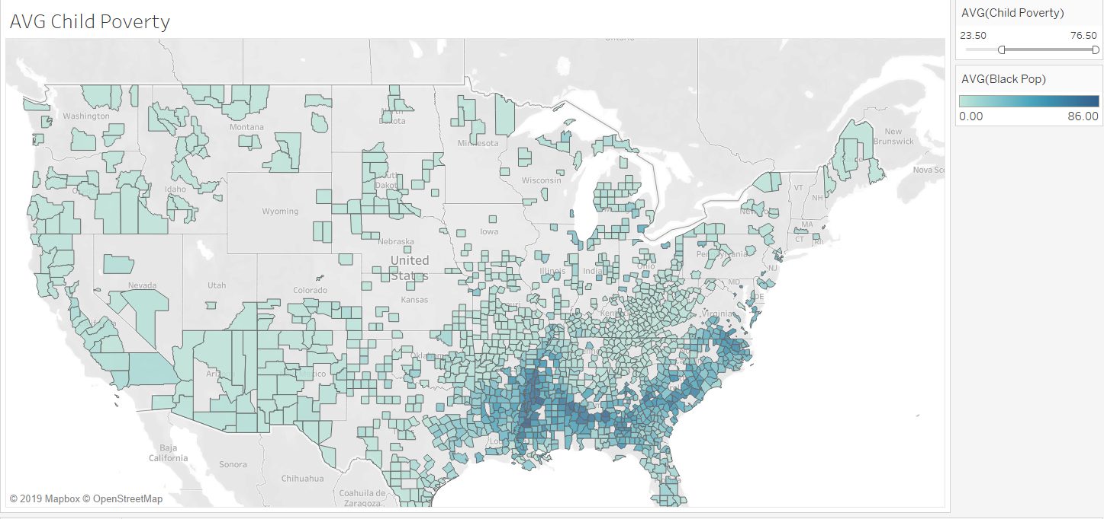
Child Poverty VS Black Population Concentration:
Viz-2
Child Poverty is weakly correlated with the proportion of black residents, showing a positive relationship.

Slide 20
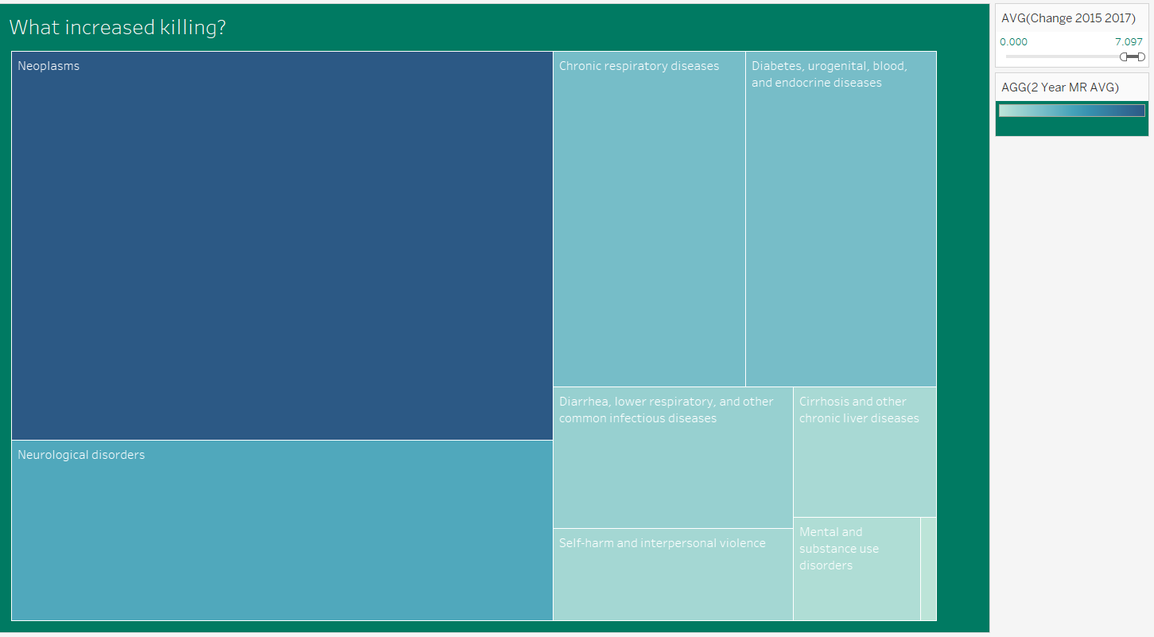

What increased the deaths?
Viz-3
Neoplasms
Neurological disorders
Chronic respiratory diseases
Diabetes, urogenital, blood, and endocrine diseases
Diarrhea, lower respiratory, and other common infectious diseases
Self-harm and interpersonal violence
Cirrhosis and other chronic liver diseases
Mental and substance use disorders
Nutritional deficiencies
Neglected tropical diseases and malaria

Slide 21
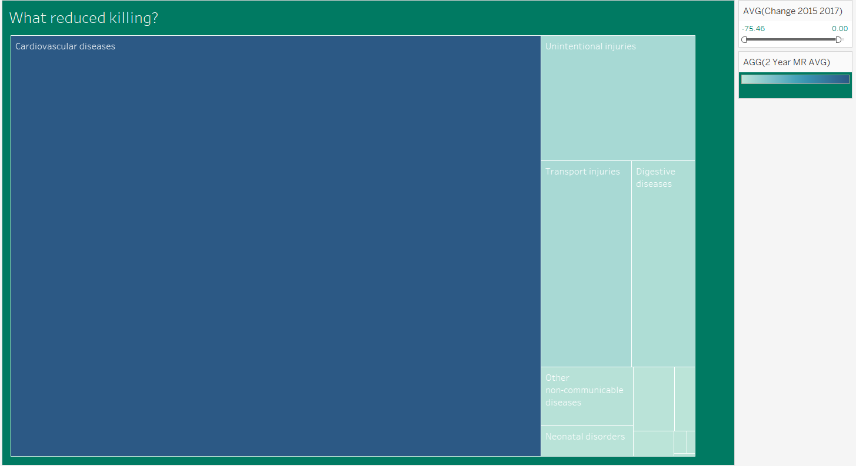

What reduced the deaths?
Viz-4
Cardiovascular diseases
Unintentional injuries
Transport injuries
Digestive diseases
Other non-communicable diseases
Neonatal disorders
Musculoskeletal disorders
HIV/AIDS and tuberculosis
Other communicable, maternal, neonatal, and nutritional diseases
Maternal disorders
Forces of nature, war, and legal intervention

Slide 22
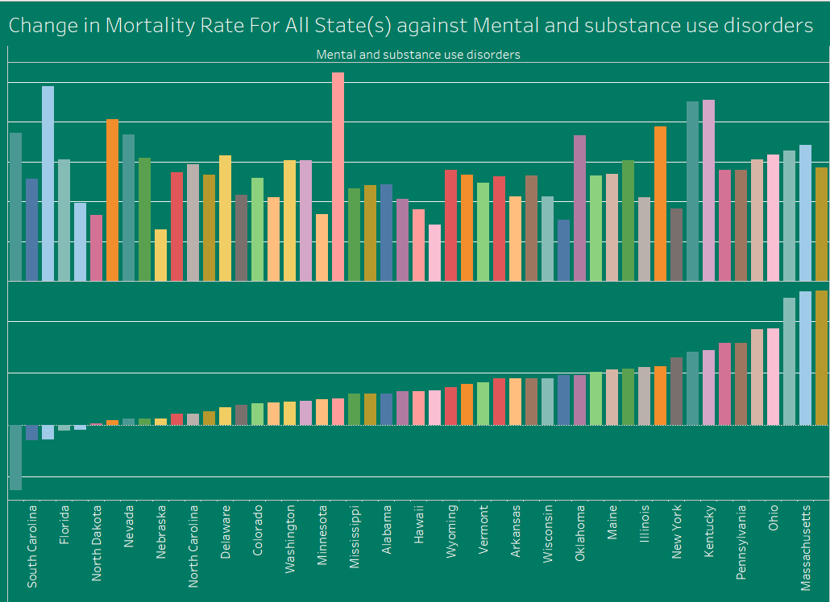

It is interesting to observe that the variation of “Mental and substance use disorders” has almost no negative values. That means that almost no State except DOC, South Carolina, Florida, Alaska, South Dakota has decreased their consumption of substances:
Viz-5
This is a pretty serious problem in USA. Fentanyl-Involved Deaths are Soaring In U.S.
Do watch how serious this is here: https://www.youtube.com/watch?v=vkhMfgOT9Xs

Slide 23
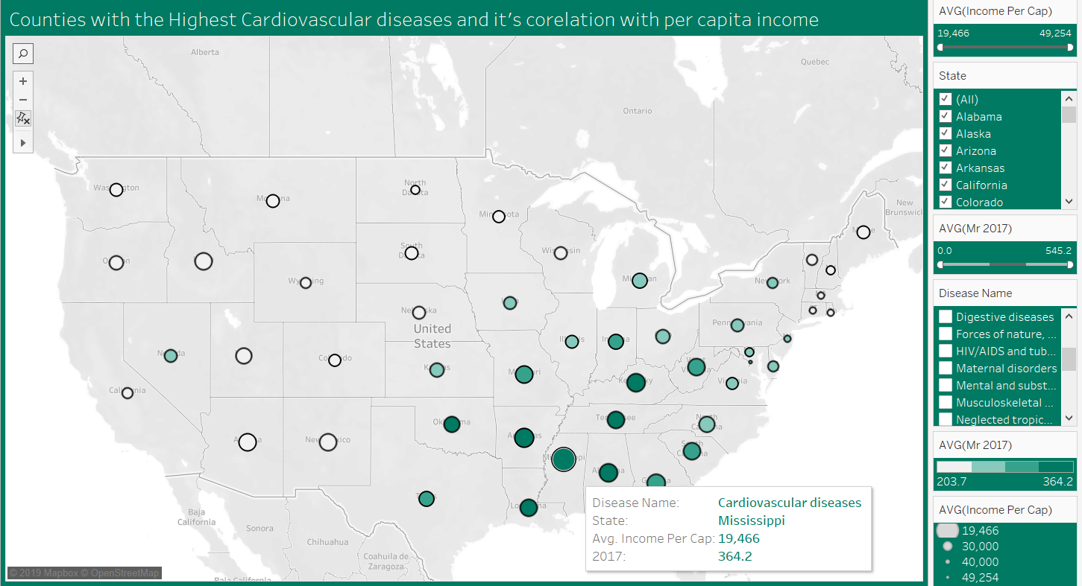

It is interesting to observe that the Mississippi has highest deaths due to Cardiovascular disease and lowest per capita income
Viz-6
Less income
equals
more junk food

Slide 24
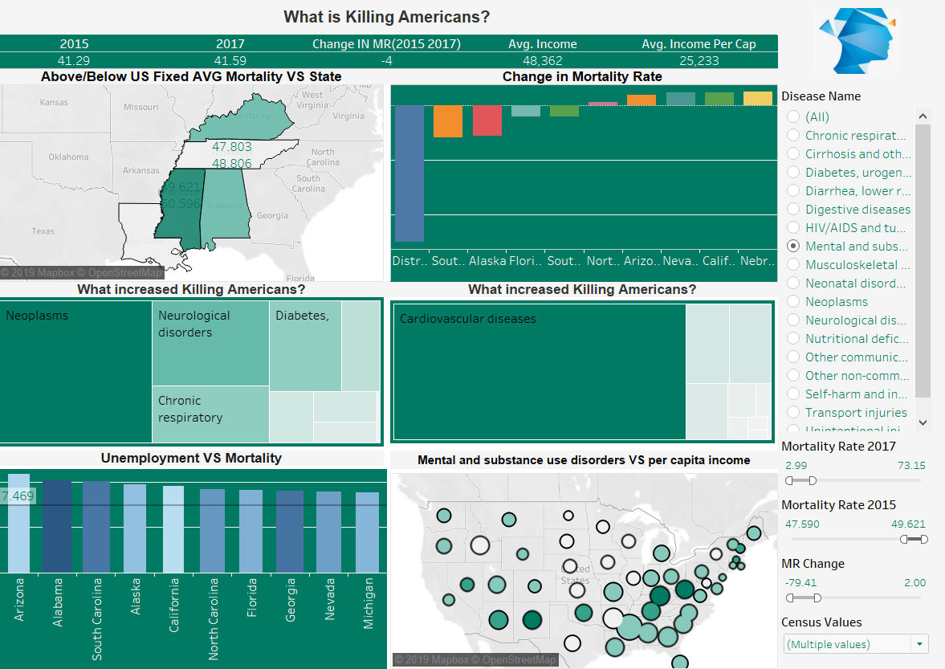
Dashboard
Viz-7

Slide 25

Recommendations

Slide 26
Interesting insights Gained from the SQL Analysis and Reports:
Growing unemployment leads to poverty:
Corson, Unemployment: 29.4, Poverty: 45.6
Kusilvak, Census Area: Unemployment: 28.8, Poverty: 39.1
Oglala Lakota, Unemployment: 28.7, Poverty: 53.3
Poverty decreases with higher income
Counties with 6 figure income has poverty within national average
Poverty encourages people to carpool:
Oglala Lakota with highest poverty has the maximum number of people using Carpool
Communities that take Transit have longer commutes:
Bronx, New York and Queens are topping the chart
Longest and Shortest County names:
Prince of Wales-Hyder Census Area: 33
Lee: 3
Natives and Poverty, Unemployment:
Oglala Lakota has highest Native Population and it is 3rd in unemployment and 1st in Poverty.
Following Counties have 100% White Population:
Jones, Webster, Jackson, Magoffin, Wheeler, Highland, Garfield, Loup
Can two states have the same county name?
The answer is a resounding, patriotic yes and coincidently there are 51 counties with names similar to the State
Commute:
More people walk in New York City than people who drive, but they do take transit. Clay, Georgia has the highest rate of carpooling.
Alaska likes to walk and, it has the lowest mean commute time as well.
Career and Income:
The highest fraction of people in a 'Professional' career live in Fall Church City, Virginia. This is the same county with third highest income.
Counties with the lowest portion of Construction jobs include Washington D.C., Florida, Rhode Island, New York and California. This is a good sanity check as they are already developed, and any level of development jobs are diluted by their large population.
Population:
The most populated County is Los Angeles, California with a population of 10105722 people The least populated County is: Loving, Texas with a population of: 74 people.
The most populated State is California with a population of 77404311 people The least populated State is: North Dakota with a population of: 1467115 people
A well thought idea of collecting Census and Mortality data is primarily to understand and improve livelihood. The results/observations shown earlier and on this page are vital inputs to the county/state/federal administrators in the policy making/ driving initiatives around healthcare and medical sectors

Slide 27

Lessons Learned

Slide 28
Lessons Learned
Complete Data wrangling process to bring necessary data required (from multiple sources) for the analysis
Data cleaning to maintain accurate records for efficient querying and visualizing processes
Data Normalization and appropriate categorization of data into respective tables
Complex queries and nuisance of SQL with the knowledge of multiple paths of getting results
Sequential process in querying, with the quest of finding more business implications from the data
Learning from encountered errors like knowing to insert records from correct folder (secure_file_priv), aggregation function (sql_mode=('ONLY_FULL_GROUP_BY',‘’))
Garbage 'IN' equals Garbage 'Out': We initially started off with very little cleaning of the data and we realized that we are not getting correct result/visualization. Example: Similar County Names leading to incorrect results. We were not aware that USA has various counties with similar names and hence, after realization concatenated the county name with the state name to get unique record
Hands on with Tableau taught usage of various kinds of charts that can be associated with a particular form a data
End of Presentation

